Slide 1

MTech Stage-1 Presentation
Structure of Associative Polymers at Surface:
A Simulation based Approach
KILAPARTHI KOUSHIK SAI
Ch24mtech11012
Computational soft matter
Advisor : Dr. Balaji Iyer V S
Department of Chemical Engineering
IIT Hyderabad

Slide 2
Literature Review
Paper Title | Authors | surface | Simulation method | Key Observations
Interfacial Structure and Dynamics of macromolecular liquids | Kevin F. Mansfield, Dores N. Theodorou | Surface | Monte Carlo Simulation | Focuses on macromolecular liquid dynamics
Interaction between plates in a polymer melt | Gerrit ten Brinke, Dominique Ausserre, Georges Hadziioannou | Surface | Lattice Monte Carlo simulation | Focuses on how polymer chain flatten or orient themselves near the plates and how this deformation depends on the distance between the plates
Interface and Surface Properties of Short Polymers in solution: Monte Carlo and self-consistent field theory | M. Muller, L. Gonzalez MacDowell | Surface | Monte Carlo, Self-Consistent Field Calculations | Examine the wetting behavior at interfaces
Polymer Loop Formation on a Functionalized hard surface: comparison of experimental and monte carlo simulation approach | Zhenyu Huang, Haining Ji, Jimmy Mays | Surface | Monte Carlo Simulation | Studies loop formation of polymers on surfaces over time
Notes:
Interfacial Structure and Dynamics of Macromolecular Liquids: A Monte Carlo Simulation Approach by Mansfield and Dores N. Theodorou

Slide 3
Motivation
Understanding polymers is crucial for designing materials systems with controlled adhesion, wetting, and lubrication characteristics.
The study aims to address how adsorptive interactions and entropic constraints influence local density, conformation, mobility.
This knowledge is essential for improving melt processing operations, such as extrusion and injection molding.
Notes:
Helps understand about the equilibrium structure. Is important for designing material systems with contolled adhesision and lubrication.
It explore how adsorption of polymers on surface will influence various properties of the system like COM distribution end-to-end vector distribution. Density distribution.

Slide 4
OBJECTIVES:
To systematically study and interpret the simulation code structure and algorithm for different types of system (confined, PBC, Z wall).
To understand the simulation methodology and energy terms (Ex and Eb) governing polymer behavior in different types of systems.
Introducing bead surface attraction energy to understand the wall attraction force on the polymer beads.

Slide 5
Associative polymer:
Associative polymers: Associative polymers are polymers containing functional groups that enable them to form reversible bonds with each other or with other chains.
Examples:
Hydrophobically modified polyacrylamide (HMPAM), Hydrophobically ethoxylated urethane (HEUR) etc
Applications:
Paints
Coatings
shampoo
Cosmetics

Slide 6
MODEL:
A cubic lattice model of dimensions of 7 x 7 x 20 in x, y and z.
Consists of 36 polymer chains each containing 20 beads.
Z- solid wall at z = 0 and z = 20L.
Beads adjacent to z = 0.5L and z = 19.5L are termed adsorbed.
Lattice representation :

Slide 7
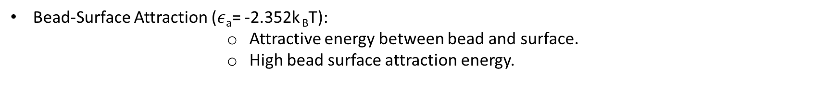
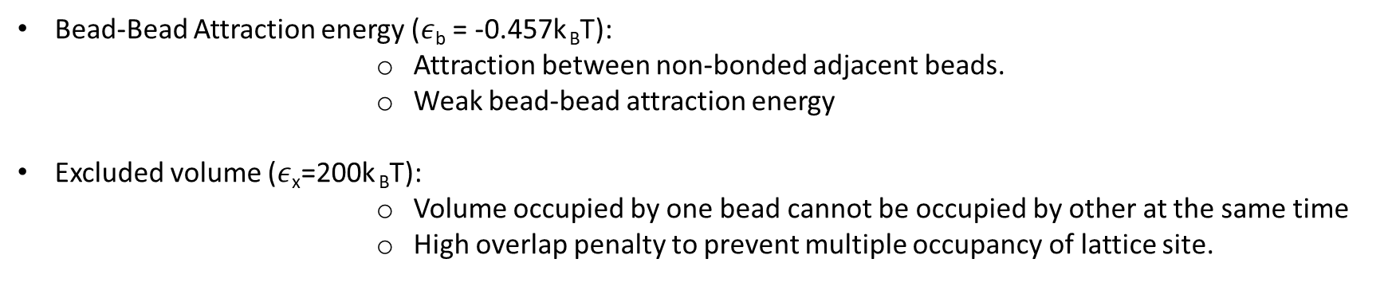
Key energy components in the simulation :
2. Interaction energies:
Bead-Bead Attraction energy ($ε$_{b} = -0.457k _{B}T):
Attraction between non-bonded adjacent beads.
Weak bead-bead attraction energy
Excluded volume ($ε$_{x}=200k _{B}T):
Volume occupied by one bead cannot be occupied by other at the same time
High overlap penalty to prevent multiple occupancy of lattice site.
Bead-Surface Attraction ($ε$_{a}= -2.352k _{B}T):
Attractive energy between bead and surface.
High bead surface attraction energy.

Slide 8










Monte Carlo Moves:
y
(YZ-plane)
MOVE: A (Non-Terminal bead movement)
z
($x_{1},y_{1}+1,z_{1}+1)$
($x_{1},y_{1 }+1,z_{1}+2)$
x
$$\left(3′\right)$$
$$\left(4\right)$$
$$\left(1\right)$$
$$\left(2\right)$$
$$\left(3\right)$$
($x_{1},y_{1},z_{1})$
($x_{1},y_{1},z_{1}+1)$
($x_{1},y_{1},z_{1}+2)$
“180°” flip of bead (3) to (3’) in yz-plane
Notes:
When x and y coordinates keeps changing and z kept constant, then it is said to be xy plane. Simillary for all the three coordinates.

Slide 9


















Monte Carlo Moves:
y
MOVE: B (Terminal bead movement), (YZ-plane)
(YZ-plane)
($x_{1},y_{1}+1,z_{1}+2)$
$$\left(4′\right)$$
($x_{1}−1,y_{1},z_{1}+2)$
z
$$\left(4′\right)$$
(xZ-plane)
x
$$\left(1\right)$$
$$\left(2\right)$$
$$\left(3\right)$$
$$\left(4\right)$$
($x_{1},y_{1},z_{1})$
($x_{1},y_{1},z_{1}+1)$
($x_{1},y_{1},z_{1}+2)$
($x_{1},y_{1},z_{1}+3)$
$$\left(4′\right)$$
($x_{1}+1,y_{1},z_{1}+2)$
$$\left(4′\right)$$
($x_{1},y_{1}−1,z_{1}+2)$
($x_{1},y_{1}+1,z_{1}+2),\text{(}x_{1},y_{1}−1,z_{1}+2)$
- In-plane movements (yz plane)
($x_{1}−1,y_{1},z_{1}+2),{(x}_{1}+1,y_{1},z_{1}+2)$
- Out-of-plane movements(xz plane)
Notes:
Here x and y kept constant and only z varies, which means it is forming a line meaning intersection of two planes. So it can be in any of the two planes.

Slide 10
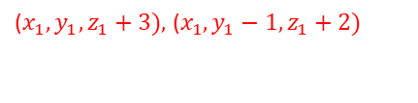










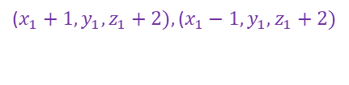





Monte Carlo Moves:
y
MOVE: C (Terminal bead movement), (YZ-plane)
(YZ-plane)
($x_{1},y_{1}+1,z_{1}+2)$
($x_{1}−1,y_{1},z_{1}+2)$
z
$$\left(4′\right)$$
$$\left(4′\right)$$
x
$$\left(1\right)$$
$$\left(2\right)$$
$$\left(3\right)$$
$$\left(4\right)$$
($x_{1},y_{1},z_{1})$
($x_{1},y_{1},z_{1}+1)$
($x_{1},y_{1},z_{1}+2)$
($x_{1},y_{1},z_{1}+3)$
$$\left(4′\right)$$
($x_{1}+1,y_{1},z_{1}+2)$
$$\left(4′\right)$$
($x_{1},y_{1}−1,z_{1}+2)$
($x_{1},y_{1},z_{1}+3)\text{, }\text{(}x_{1},y_{1}−1,z_{1}+2)$
- In-plane movements (yz plane)
$$\text{(}x_{1}+1,y_{1},z_{1}+2),\text{(}x_{1}−1,y_{1},z_{1}+2)$$
- Out-of-plane movements (xy plane)

Slide 11
TYPES OF SYSTEMS:
System | Box boundaries | Physical walls | Periodic Boundaries
Confined | Yes | Yes | No
PBC | Yes | No | Yes
Z-wall | Yes | Yes (only in z) | Yes (only in x and y)
Notes:
Why does a move from low to high energy have a non-zero probability, instead of being totally avoided ? The model was created in a way that it should closely relate the real-life polymer. In real polymer actually jiggle (when T>0)and sometimes jump into higher energy states. So as to capture that behaviour there is probabilistic chance (less often). If rejected then it doesn’t show a proper real statistical behaviour and not a proper configuration as of a real polymer.

Slide 12
Algorithm for initial configuration of chains:
For the arrangement of chains:
Create a file chains.csv with header x,y,z.
Choose any of the four defined subroutines (diagonal(), xarrange(), yarrange(), randomize())
for each chain (i = 0 to 35),
for each bead (j = 0 to 19),
prints the bead coordinates
Write bead coordinates to chains.csv and close the file
Notes:
Conditional probability q(i,j) is p(bead selection). P(move making/ selected bead).

Slide 13
Algorithm:
Main structure:
Initialize variables, RNG seed and read the bead positions from file chains.csv
Update the occupation status and details of lattice sites using sstate()
Writes initial configuration to the file mchains.csv.
while (total moves < maximum moves (10⁸))
Randomly choose a chain(cnum) and direction for the bead to move
Depending on the bead(first, last or internal), the equal move subroutine is called (fmoves, nmoves, kmoves).
Calculate energy change and apply metropolis acceptance (metrop(delE)).
Write intermediate bead coordinates to mchainsfn.csv for every 5 x 10⁶ moves.
write final bead configuration to mchainsf.csv
Notes:
Conditional probability q(i,j) is p(bead selection). P(move making/ selected bead).

Slide 14
Moves Handling:
System | fmoves | nmoves | kmoves
Confined | Move the first bead and resets if its out. | Move the last bead and resets if its out. | Move the internal bead and resets if its out.
PBC | Move the first bead and wraps around if out | Move the last bead and wraps around if out | Move the internal bead and wraps around if out
Z-wall | Move the first bead and wraps around in x, y and blocks in z | Move the last bead and wraps around in x, y and blocks in z | Move the internal bead and wraps around in x, y and blocks in z

Slide 15





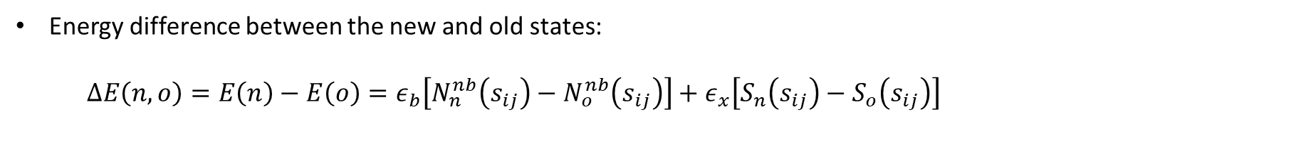







Energy calculations:
$ε_{b}$ = -0.457 k _{B}T, $ε_{x}$= 200 k _{B}T
Energy difference between the new and old states:
$∆E\left(n,o\right)=E\left(n\right)−E\left(o\right)=ε_{b}\left[N_{n}^{nb}\left(s_{ij}\right)−N_{o}^{nb}\left(s_{ij}\right)\right]+ε_{x}\left[S_{n}\left(s_{ij}\right)−S_{o}\left(s_{ij}\right)\right]$ $+ε_{a}\left[A_{n}\left(s_{ij}\right)−A_{o}\left(s_{ij}\right)\right]$
$$+ε_{a}\left[A_{n}\left(s_{ij}\right)−A_{o}\left(s_{ij}\right)\right]$$
Old state(o):
$$s_{ij}$$
$$s_{ij}$$
$$S_{o}\left(s_{ij}\right)=1$$
$N_{n}^{nb}\left(s_{ij}\right)$ = 2
$N_{n}^{nb}\left(s_{ij}\right)$ = 1
$$s_{ij}$$
$$S_{n}\left(s_{ij}\right)=2$$
New state(n):
$$s_{ij}$$
$$s_{ij}$$
$N_{n}^{nb}\left(s_{ij}\right)$ = 2
$N_{n}^{nb}\left(s_{ij}\right)$ = 3

Slide 16

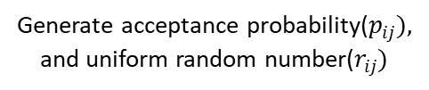


Flow diagram:
Metropolis [metrop(delE)]:
start
Initialize int acc; double $r_{ij}$,$p_{ij}$
Note: $p_{ij}$ = exp(-delE)
Check if
energy change
(delE) <=0
no
Generate acceptance probability($p_{ij}),$
and uniform random number($r_{ij})$
yes
no
if
($p_{ij}$< $r_{ij}$)
Move is accepted
yes
Move is rejected
end

Slide 17
Long- Term Vision:
To understand the wall attraction force on the polymer beads.
Study polymer conformation by varying the wall attraction energy.
Introducing dynamics to explore bead movements on surfaces.

Slide 18
Acknowledgement
I would like to extend my heartfelt gratitude to Dr. Balaji Iyer;
Mrs. Haritha P.
who has helped me get better insights and understand the concept at a better level. Your continuous help and guidance is much required in this journey forward.

Slide 19
THANK YOU

Slide 20
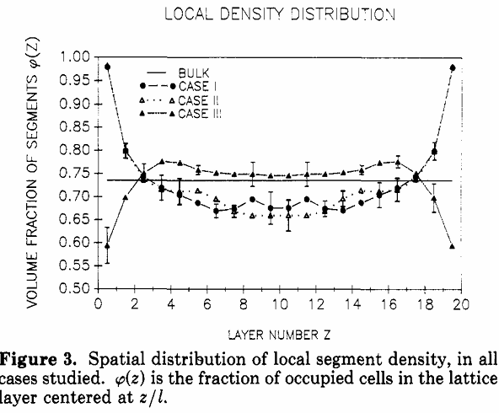

RESULTS AND DISCUSSION:
Binning Scheme
(20 parallel bins)
Volume fraction of segments
Φ(z) = $\frac{n\left(z\right)}{L}$
Cases -1 and 2 are identical.
Strong adsorption has more segment density.
Weak adsorption has less segment density.

Slide 21
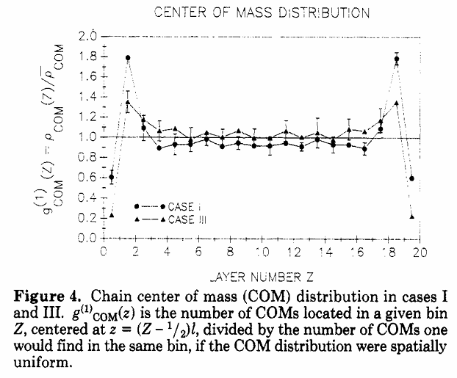
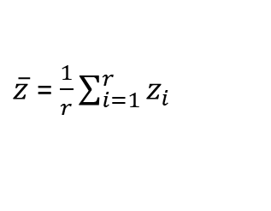

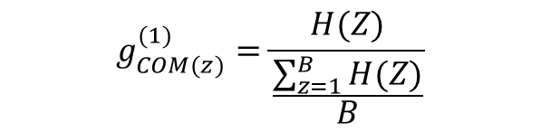
RESULTS AND DISCUSSION:
COM of individual chain
$\overline{z}$ = $\frac{1}{r}\sum_{i=1}^{r}{z_{i} }$
Normalized value
$$g_{COM(z)}^{(1)}=\frac{H(Z)}{\frac{\sum_{z=1}^{B}{H(Z)}}{B}}$$
$H(Z)$ = number of hits

Slide 22
In the context of our study, where the objective is to understand the evolving structure of polymer chains at and near interfaces, it becomes imperative to define metrics that capture structural characteristics. Visualization alone is insufficient; structural evolution must be tracked through quantifiable parameters that reflect both spatial and configurational features of the chains over time.
To this end, we consider the following key parameters:
End-to-End Distance (Re): it is the straight-line distance between the two terminal beads of a polymer chain.
Radius of Gyration (Rg): Reflects the distribution of the polymer’s mass around its center of mass, offering a more averaged measure of compactness or spread.
Segment Density (ρ(z)): Denotes the number of polymer segments within a defined spatial slice (typically along the z-axis), thus revealing layering effects and confinement-induced ordering.
These metrics serve as proxies for interpreting the conformational and structural characteristics of the polymer system under different conditions, and their evolution over time offers a pathway to understanding the underlying physics driving polymer behavior at surfaces or in confined environments.

Slide 23
SIMULATION:
3. Simulation Stages :
Equilibrium stage-1:
100×10⁶ bead cycles (to designate an attempted move)
Monitored convergence of chain dimensions.

Slide 24
SIMULATION:
y
1. Monte Carlo Moves:
z
A
B
C
x
A (Non-Terminal bead movement)
B/C (Terminal bead movement)

Slide 25





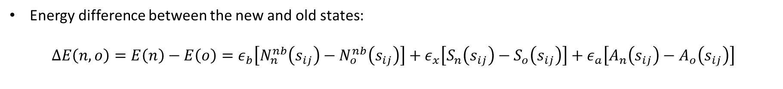






SIMULATION:
Energy difference between the new and old states:
$$∆E\left(n,o\right)=E\left(n\right)−E\left(o\right)=ε_{b}\left[N_{n}^{nb}\left(s_{ij}\right)−N_{o}^{nb}\left(s_{ij}\right)\right]+ε_{x}\left[S_{n}\left(s_{ij}\right)−S_{o}\left(s_{ij}\right)\right]+ε_{a}\left[A_{n}\left(s_{ij}\right)−A_{o}\left(s_{ij}\right)\right]$$
$$s_{ij}$$
$A_{j}\left(s_{ij}\right)$ = 0
$$ε_{b}$$
$$ε_{b}$$
$$S_{i}\left(s_{ij}\right)=1$$
State n:
$$s_{ij}$$
$$S_{j}\left(s_{ij}\right)=2$$
State o:
$$ε_{b}$$
$$ε_{b}$$
$A_{j}\left(s_{ij}\right)$ = 1
$$ε_{b}$$
$$s_{ij}$$
$$ε_{a}$$
Wall-surface

Slide 26
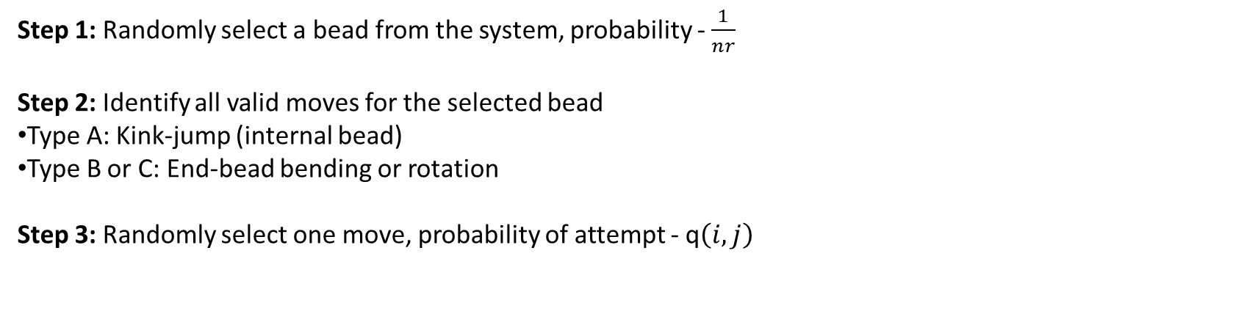
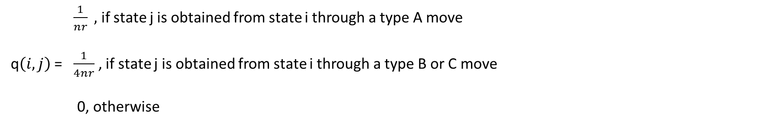
SIMULATION:
Metropolis algorithm:
The algorithm that is used to evolve the configuration of a polymer
Step 1: Randomly select a bead from the system, probability - $\frac{1}{nr}$
Step 2: Identify all valid moves for the selected bead
Type A: Kink-jump (internal bead)
Type B or C: End-bead bending or rotation
Step 3: Randomly select one move, probability of attempt - q$\left(i,j\right)$
​$\frac{1}{nr} ,$if state j is obtained from state i through a type A move
q$\left(i,j\right)$ = ​$\frac{1}{4nr}$, if state j is obtained from state i through a type B or C move
0, otherwise
Notes:
Conditional probability q(i,j) is p(bead selection). P(move making/ selected bead).

Slide 27
MODEL:
With L = 2.76 $Å.$
T = 473 K, P = 1 atm.
Case | Bead –bead strength (ε_{b}) | Excluded volume (ε_{x}) | Surface Barrier (εₛ) | Adsorptive Strength (εₐ) | Surface Type
I | Weak(−0.457 k _{B}T) | Strong (200 k _{B}T) | Strong (2.352 k _{B}T) | Strong (−2.352 k _{B}T) | Not Smooth, Strongly Adsorbing
II | Weak(−0.457 k _{B}T) | Strong (200 k _{B}T) | None (0.000 k _{B}T) | Strong (−2.352 k _{B}T) | Smooth, Strongly Adsorbing
III | Weak(−0.457 k _{B}T) | Strong (200 k _{B}T) | Weak (0.336 k _{B}T) | Weak (−0.336 k _{B}T) | Smooth, Weakly Adsorbing

Slide 28
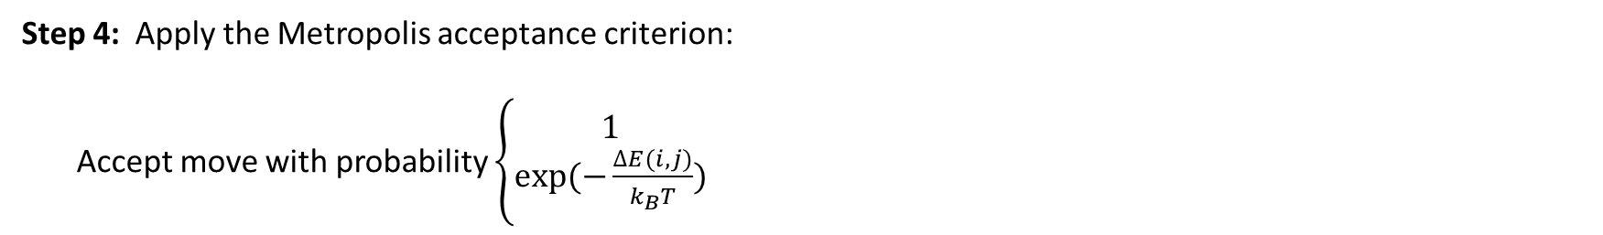


SIMULATION:
Step 4: Apply the Metropolis acceptance criterion:
Accept move with probability $\left\{\begin{aligned}1 \\ exp⁡(−\frac{∆E(i,j)}{k_{B}T})\end{aligned}\right.$
$$if ∆E≤0$$
$$if ∆E>0$$
Step 5:
If accepted → update system to new state j.
If rejected → stay in current state i.
Notes:
Why does a move from low to high energy have a non-zero probability, instead of being totally avoided ? The model was created in a way that it should closely relate the real-life polymer. In real polymer actually jiggle (when T>0)and sometimes jump into higher energy states. So as to capture that behaviour there is probabilistic chance (less often). If rejected then it doesn’t show a proper real statistical behaviour and not a proper configuration as of a real polymer.

